Slide 1



Ain Shams University جامعة عين شمس
Faculty of Engineering كليـة الهندسة
Diagnostic Communication Manager (DCM V1.0) ASUSAR V2.0
“
AUTOSAR Standard: Classic Platform. Standard Release: 4.3.1. Protocol Standard: ISO 14229 - Unified Diagnostic Services (UDS).
Team Members Ahmed Magdy Ibrahim 14P8208 Ahmed Mahmoud Elkhateeb 1500187 Adel Heder Tokan 1500743 Aamer Muhamed Elbaz 15P8121
Supervision Prof. Dr. Sherif Hammad Eng. Muhamad Abdullhay Eng. Nawaf Alhazza
SPRING 2020

Slide 2
PRESENTATION OVERVIEW
1.0
INTRODUCTION
Overview on AUTOSAR Diagnosis System.
2.0
SUPPORTED SERVICES
Supported UDS Services in DCM Module.
3.0
SERVICE LIFE CYCLE
The Path of the Service through the Module.
4.0
MODULE FLEXIBILITY
Configuration Parameters, Module Extendibility.
HIGHLIGHT
5.0
DOCUMENTATION
Documentation Forms.
6.0
DCM DEMO
Simulation for Diagnosis Tester Tool.

Slide 3
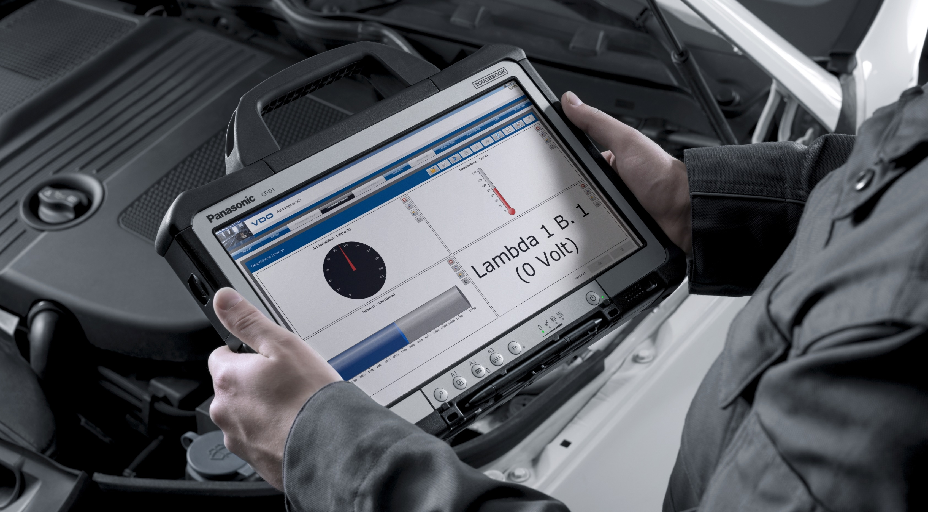
ISO 14229 - Unified Diagnostic Services (UDS). Diagnostic Communication Manager (DCM).
1.0
INTRODUCTION
1.1
Why Diagnosis?
● Sensors Calibration
● ECU Resetting.
● Read and Override data on the ECU. ● Get Diagnostic Trouble Codes (DTCs).
Figure: Diagnosis Tool.

Slide 4
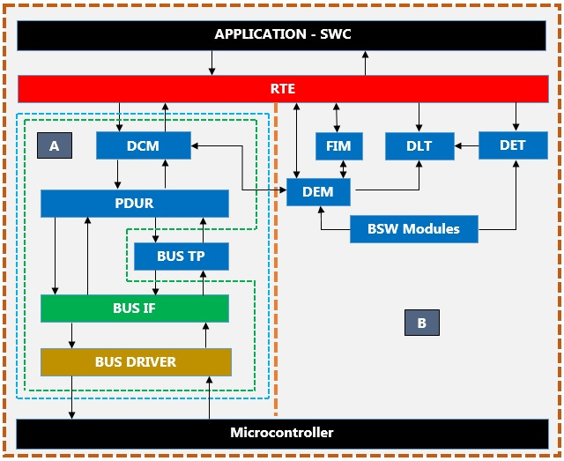
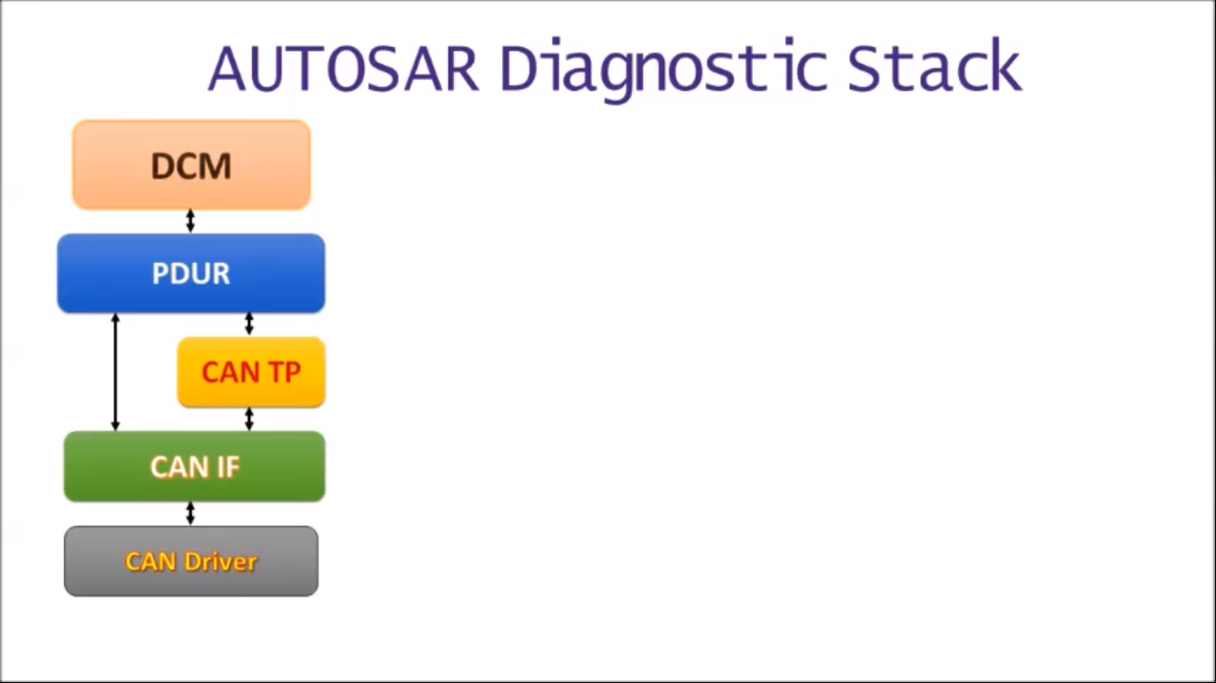
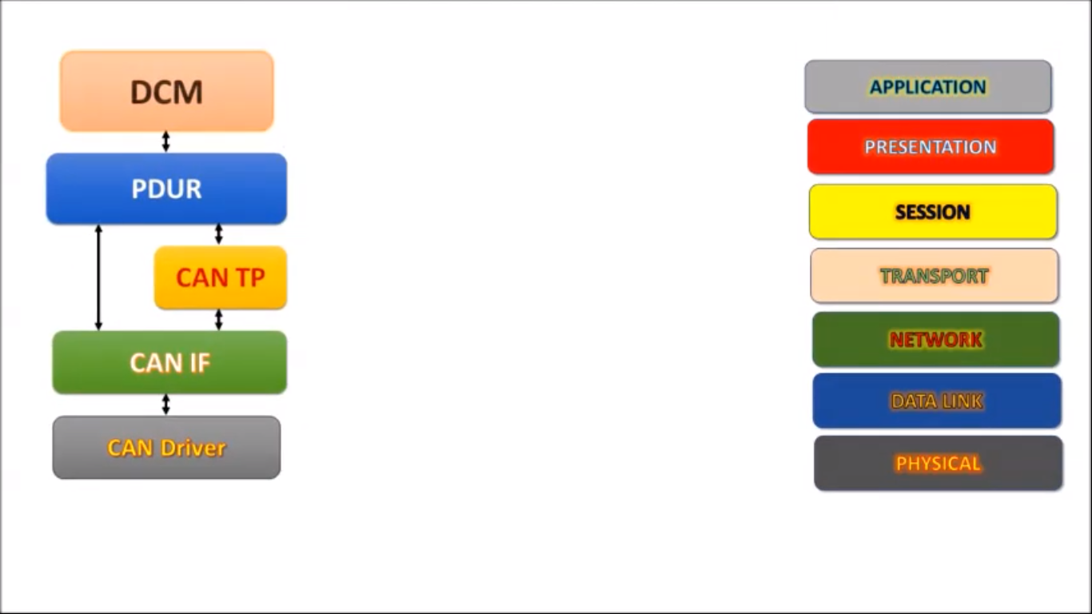

ISO 14229 - Unified Diagnostic Services (UDS). Diagnostic Communication Manager (DCM).
1.0
INTRODUCTION
1.2
Diagnosis Layered Architecture
COM
Figure: Diagnosis Stack Mapping to OSI.
Figure: Diagnosis Stack in AUTOSAR Layered Architecture.

Slide 5


ISO 14229 - Unified Diagnostic Services (UDS). Diagnostic Communication Manager (DCM).
1.0
INTRODUCTION
1.3
Diagnostic Communication Manager (DCM) Overview
Application
RTE
DCM
Tester Request
SID(M)
Sub-Func(C/S)
Data Record(M/C/U)
DCM Positive Response
1st Byte
N-Bytes
DCM Negative Response
SID + 0x40
Sub-Func
Data Record
2nd Byte
0x7F
SID
NRC
3rd Byte
1st Byte
2nd Byte
N-Bytes
1st Byte
2nd Byte

Slide 6

ISO 14229 - Unified Diagnostic Services (UDS). Diagnostic Communication Manager (DCM).
1.0
INTRODUCTION
Application
1.3
Diagnostic Communication Manager (DCM) Overview
RTE
DCM
1.3.1
Diagnostic Session Layer (DSL)
DSP
● Guarantees Response Timing to Tester.
● Guarantees Diagnostic Protocol Timing.
DSD
1.3.2
Diagnostic Service Dispatcher (DSD)
● Diagnostic Requested Service Verifications.
● Delegates Internal and External Services.
DSL
1.3.3
Diagnostic Service Processing (DSP)
● Diagnostic Requested Sub Service Verifications if found.
● Processes the Internal Services and Sub Services.
PDUR
Figure: Diagnostic Communication Manager (DCM).

Slide 7
ISO 14229 - Unified Diagnostic Services (UDS). Diagnostic Communication Manager (DCM).
2.0
SUPPORTED SERVICES
Diagnostic Session Control
0x10
2.1
Internal Services
0x3E
2.2
Tester Present
DCM
0x22
2.3
Read Data by Identifier
Write Data by Identifier
0x2E
2.4
External Services
0x27
2.5
Security Access
Application
0x31
RTE
2.6
Routine Control
DCM

Slide 8

ISO 14229 - Unified Diagnostic Services (UDS). Diagnostic Communication Manager (DCM).
2.0
SUPPORTED SERVICES
Diagnostic Session Control
0x10
2.1
DCM
DCM Session Level
Extended
Default
Client
Session Control – SID: 0x10 ● To switch the Session Level
0x02
0x00
0x10
Sub-Func
1st Byte
2nd Byte

Slide 9


ISO 14229 - Unified Diagnostic Services (UDS). Diagnostic Communication Manager (DCM).
2.0
SUPPORTED SERVICES
Tester Present
0x3E
2.2
DCM
DSP
Extended
S3 Server Timeout Timer
Concurrent Tester Present
Default
DSL
Client
Tester Present – SID: 0x3E ● To Keep Non-Default Session Active
0x80
0x00
0x3E
Sub-Func
1st Byte
2nd Byte

Slide 10
ISO 14229 - Unified Diagnostic Services (UDS). Diagnostic Communication Manager (DCM).
2.0
SUPPORTED SERVICES
Read Data by Identifier
0x22
2.3
Application
Vin Number: W0L000043MB541326
RTE
i.e Vin Number
DCM
DSP
Client
0x22+0x40
DID
DID
Data
Data Identifier
W0L000043MB541326
1st Byte
2nd + 3rd Byte
Read Data By Identifier – SID: 0x22 ● To Read certain Data specified by ID
0x22
DID
DID
1st Byte
2nd + 3rd Byte
4th + 5th Byte

Slide 11

ISO 14229 - Unified Diagnostic Services (UDS). Diagnostic Communication Manager (DCM).
2.0
SUPPORTED SERVICES
Write Data by Identifier
0x2E
2.4
Application
Vin Number: W0L000043MB541326
RTE
i.e Vin Number
DCM
DSP
Client
Data Identifier
Write Data By Identifier – SID: 0x2E ● To Write certain Data specified by ID
0x2E
DID
W0L000043MB541326
1st Byte
2nd + 3rd Byte

Slide 12

ISO 14229 - Unified Diagnostic Services (UDS). Diagnostic Communication Manager (DCM).
2.0
SUPPORTED SERVICES
Security Access
0x27
2.3
Seed:
Application
On Boot Timer
Algorithm
RTE
DCM
Key:
DSP
0xC9 0xA9
Seed
Client
N [0x01 : 0x3E] Odd
0x27+0x40
N
0x36 0x57
1st Byte
2nd Byte
Seed
Security Access – SID: 0x27 ● To Change Security level of Data or Service
0x27
Sub-Func
1st Byte
2nd Byte

Slide 13
ISO 14229 - Unified Diagnostic Services (UDS). Diagnostic Communication Manager (DCM).
2.0
SUPPORTED SERVICES
Security Access
0x27
2.5
Seed:
Application
0x36 0x57
Algorithm
RTE
DCM
Key:
DSP
0xC9 0xA9
Key
Client
N+1 [0x01 : 0x3E] Even
Invalid Key
Valid Key
Security Access – SID: 0x27 ● To Change Security level of Data or Service
0x27
Sub-Func
0xC9 0xF6
1st Byte
2nd Byte

Slide 14
ISO 14229 - Unified Diagnostic Services (UDS). Diagnostic Communication Manager (DCM).
2.0
SUPPORTED SERVICES
Routine Control
0x31
2.6
Application
RTE
DCM
Routine Identifier
DSP
START
STOP
Request Routine Results
Client
0x31+0x40
Sub-Func
RID
Routine Results
0x01
0x02
0x03
1st Byte
2nd Byte
3rd + 4th Byte
Routine Control – SID: 0x31 ● To Start, Stop, Request Routine Results
0x31
Sub-Func
RID
1st Byte
2nd Byte
3rd + 4th Byte

Slide 15
ISO 14229 - Unified Diagnostic Services (UDS). Diagnostic Communication Manager (DCM).
3.0
SERVICE LIFE CYCLE
Application
RTE
DCM
DSP
RESPONSE
REQUEST
DSD
DSL
PDUR

Slide 16
ISO 14229 - Unified Diagnostic Services (UDS). Diagnostic Communication Manager (DCM).
3.0
SERVICE LIFE CYCLE
Protocol
UDS
DCM
DSD
Protocol Row
*
DSL
Copying Data to DCM
UDS_ON Ethernet
UDS_ON CAN
UDS_ON Flexray
UDS_ON LIN
Indicate DSD
Buffer
Connection*
Refresh (S3 Server) & (P2 – P2*) Timeout Timers
Concurrent Tester Present
Main Connection
Connect Channel
Channels
*
Tx
Func. Rx
Phys. Rx
PDUR

Slide 17
ISO 14229 - Unified Diagnostic Services (UDS). Diagnostic Communication Manager (DCM).
3.0
SERVICE LIFE CYCLE
● DSD: Service Verification
DCM
DSP
SID(M)
Sub-Func(C/S)
Data Record(M/C/U)
DSD
1st Byte
2nd Byte
N-Bytes
Indicate DSP
SID | Service Name
0x10 | Session Control
0x22 | Read Data by Identifier
0x2E | Write Data by Identifier
0x27 | Security Access
0x31 | Routine Control
0x3E | Tester Present
Session Level
Disassemble SID
Security Level
Service Table
DSL

Slide 18
ISO 14229 - Unified Diagnostic Services (UDS). Diagnostic Communication Manager (DCM).
3.0
SERVICE LIFE CYCLE
● DSP: Sub - Service Verification
RTE
DCM
SID(M)
Sub-Func(C/S)
Data Record(M/C/U)
DSP
External Service
1st Byte
2nd Byte
N-Bytes
Sub SID | Sub Service Name
0x01 | i.e Start Routine
0x02 | i.e Stop Routine
0x03 | i.e Request Routine Results
Service
Sub Service
Internal Service
Processing
DSD

Slide 19
ISO 14229 - Unified Diagnostic Services (UDS). Diagnostic Communication Manager (DCM).
3.0
SERVICE LIFE CYCLE
Application
RTE
RTE Port Configuration
DCM

Slide 20
ISO 14229 - Unified Diagnostic Services (UDS). Diagnostic Communication Manager (DCM).
3.0
SERVICE LIFE CYCLE
RTE
DCM
DSP
Pending Response
Response
Positive/Negative Response
DSD

Slide 21
ISO 14229 - Unified Diagnostic Services (UDS). Diagnostic Communication Manager (DCM).
3.0
SERVICE LIFE CYCLE
DCM
DSP
DSD
Response
Create Positive Response Frame
Create Negative Response Frame
DSL

Slide 22
ISO 14229 - Unified Diagnostic Services (UDS). Diagnostic Communication Manager (DCM).
3.0
SERVICE LIFE CYCLE
DCM
DSD
DSL
Release DCM Module
Copying Data to CANIF
Confirmation
PDUR

Slide 23
Protocol
Protocol
UDS
OBD
4.0
MODULE FLEXIBILITY
4.1
Module Configurability
Protocol Row
*
● Configuration Parameters. ● Enable/Disable Features.
i.e Detect Error Tracer(DET), Services ...etc.
UDS_ON Flexray
UDS_ON CAN
UDS_ON Ethernet
UDS_ON LIN
Connection*
Connection*
4.2
Module Extendibility
Main Connection
Main Connection
*
*
Tx
Func. Rx
Phys. Rx
Tx
Func. Rx
Phys. Rx

Slide 24
ISO 14229 - Unified Diagnostic Services (UDS). Diagnostic Communication Manager (DCM).
5.0
DOCUMENTATION
5.1
Doxygen
5.2
Code Documentation
5.3
SWS Tags Report
5.4
Thesis
5.5
Mark Down
5.6
Videos

Slide 25
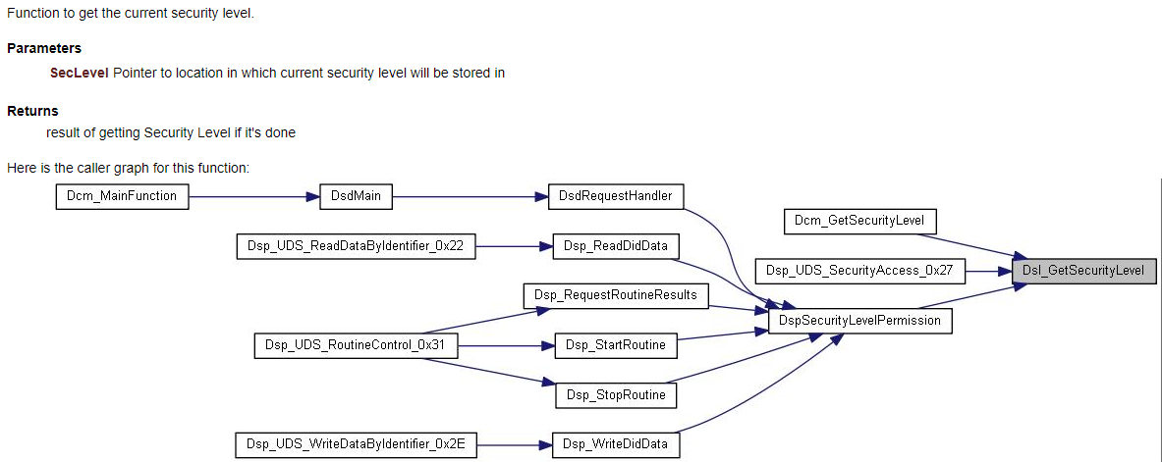
ISO 14229 - Unified Diagnostic Services (UDS). Diagnostic Communication Manager (DCM).
5.0
DOCUMENTATION
5.1
Doxygen
Link: diagnostic-commuincation.000webhostapp.com

Slide 26
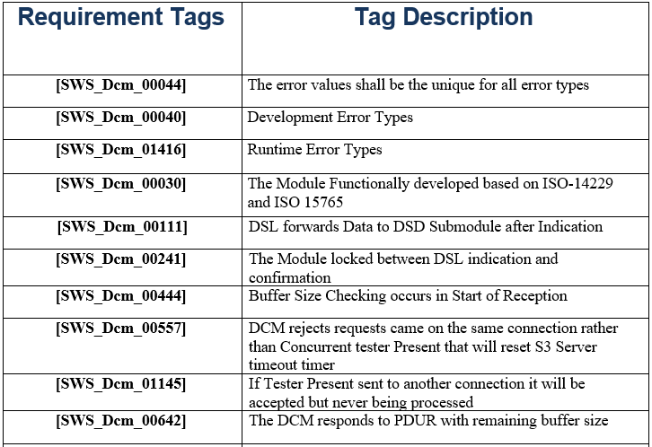
ISO 14229 - Unified Diagnostic Services (UDS). Diagnostic Communication Manager (DCM).
5.0
DOCUMENTATION
5.3
Tags Report

Slide 27
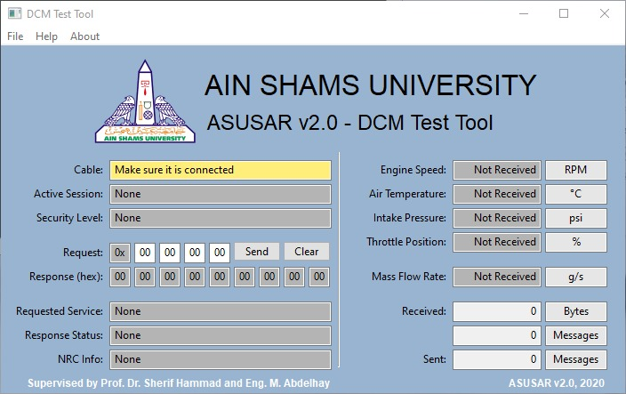
ISO 14229 - Unified Diagnostic Services (UDS). Diagnostic Communication Manager (DCM).
6.0
DCM DEMO

Slide 28
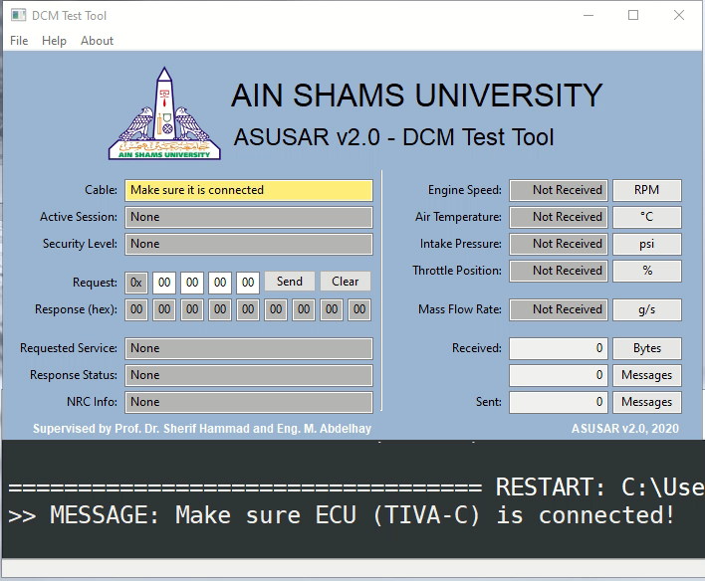
ISO 14229 - Unified Diagnostic Services (UDS). Diagnostic Communication Manager (DCM).
6.0
DCM DEMO

Slide 29
Ain Shams University جامعة عين شمس
Faculty of Engineering كليـة الهندسة
“
THANK YOU

